Slide 1





Presentation of HEGO Project and planned activities for the development of the herb sector and plant products with commercial value added, in Black Sea Basin
Tassos LIVADIOTIS
Project Coordinator: ANETXA SA - Development Association of Halkidiki S.A., Greece
1st DISSEMINATION EVENT IN THE REPUBLIC OF MOLDOVA
“HEGO - Herbs for Growth” (Project: BSB 987)
Date:12.10.2021, 10.00am (GMT+3), Location: Online/Platform ZOOM

Slide 2




Few facts about our project…
It is funded by the European Neighborhood Instrument (ENI) through the Black Sea Basin 2014-2020 Programme (BSB)
Programme priority: 1 Promote business and entrepreneurship within the Black Sea Basin
Specific objective: 1.2 Increase cross-border trade opportunities and modernisation in the agricultural and connected sectors
Approval by the Joint Monitoring Committee: September, 2019
Total Budget | 745.983,00
ENI Cofinancing (92%) | 686.304,36
Public Contribution (8%) | 59.678,64
Duration: 30 months
Start date: July 1, 2020
End date: December 31, 2022

Slide 3
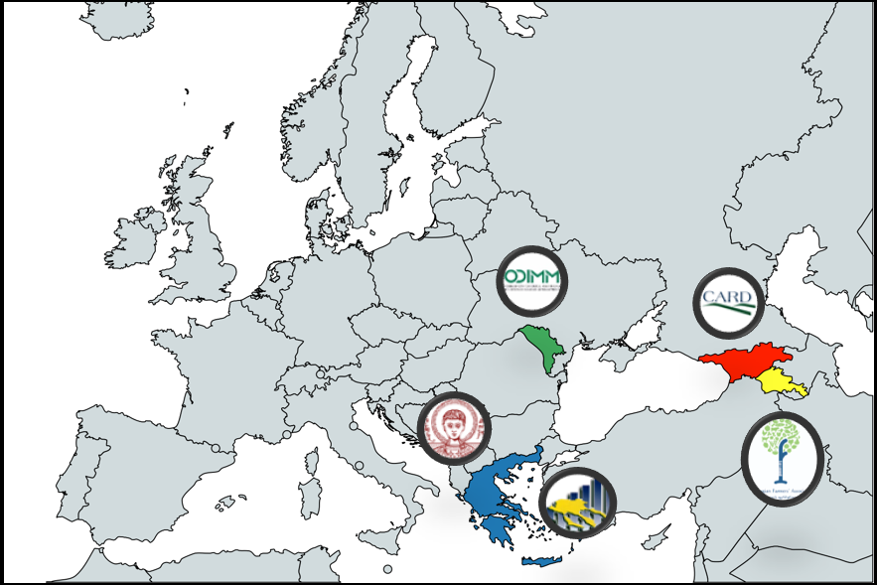
5 Partners from 4 countries
LP: Development Association of Halkidiki S.A. – Organization for Local Development (ANETXA)
PP1: Aristotle University of Thessaloniki (AUTH)
PP3: Organization for Small and Medium Enterprises Sector Development (ODIMM)
PP4: Georgian Farmers' Association (GFA)
PP5: Center of Agribusiness and Rural Development Foundation (CARD)

Slide 4
The idea behind our project
All areas face common challenges in an ever changing world:
We share a rich biodiversity and endemism of herb plant species, as well as an interconnected herbal medicine and food historical tradition. However…..
the overexploitation of wild growing endangered and endemic herb plant species, due to the inappropriate collection methods from the wild and….
the rapidly growing demand for herb products to 2025 (according to recent studies), resulted to….
an unsustainable wild growing herbs utilization as well as production efficiency.
Thus….
The unsustainable and doubtful economic future of local people in areas with rich biodiversity, like the mountainous population in Project countries, is the bottom line of these environmental and socio-economic risks.

Slide 5
Project Objectives
Project Specific Objectives
Overall Objective
Positive Impact
PSO1: Modernisation of herb enterprises
PSO2: Networking and establishing trade linkages
The modernisation of enterprises associated with cultivation, production and promotion of diversified, sustainable, value added herb products and the enhancement of cross-border trade opportunities for local herb enterprises in all project countries (Greece, Moldova, Georgia and Armenia).
A change in the production model of herb products, which will lead to improving the economic and business performance of the herb sector and indirectly on contributing to the biodiversity conservation of endemic herb plant species.

Slide 6

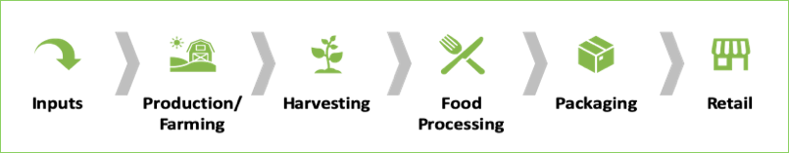
Project Main Activities & Target Groups
HEGO Project will try to achieve the above mentioned objectives by:
Organising Education and Training schemes
Supporting Marketing and branding efforts
Facilitating Synergies and Networking among stakeholders
by providing the following related tools:
  an integrated training programme/seminars,
  an e-learning platform (hosted by AUTH),
  an e-Business Portal (hosted by ODIMM),
  a Black Sea Herb Business Forum (and conferences),
  the first “Black Sea Herb Cluster” preparatory folder.
Target Groups
Farmers/collectors of herbs (SMEs)
Business Support Organisations
Local/Regional/National Authorities
Manufacturing/packaging (SMEs)
Traders/exporters (SMEs)
Promoters/ Marketing professionals (SMEs)
Educations institutions (Universities, Institutes etc)
Sectoral Associations and agencies
Interest Groups including NGOs
Others

Slide 7

Workplan – 6 Groups of Activities
GA [M]-Management
Jul.20 – Dec.22
GA [T2]-Training programme for modernization of herb enterprises
Jan.21 – Jun.22
GA [T4]-Preparatory actions for “Black Sea Herb Cluster”
Jul.20 – Dec.22
GA [T1]-Market Research for current situation and training needs on herb sector
Jul.20 – Apr.21
GA [T3]-Establishment and operation of the network “Black Sea Herb Business Forum”
GA [C]-Communication
Jul.20 – Dec.22
Jan.21 – Dec.22

Slide 8

GA [M]-Management
Jul.20 – Dec.22
Activity A.M.1-Project coordination, financial monitoring & internal communication
Deliverable D.M.1.1 - Progress Narrative Reports
Deliverable D.M.1.2 - Financial Reports
Activity A.M.2-Project meetings
Deliverable D.M.2.1 - Project meetings reports
Activity A.M.3-Quality assessment & Project performance
Deliverable D.M.3.1 - Quality assessment & Project performance plan
Activity A.M.4-Verifications of expenses
Deliverable D.M.4.1 - Verifications' Reports [2 reports per partner]

Slide 9

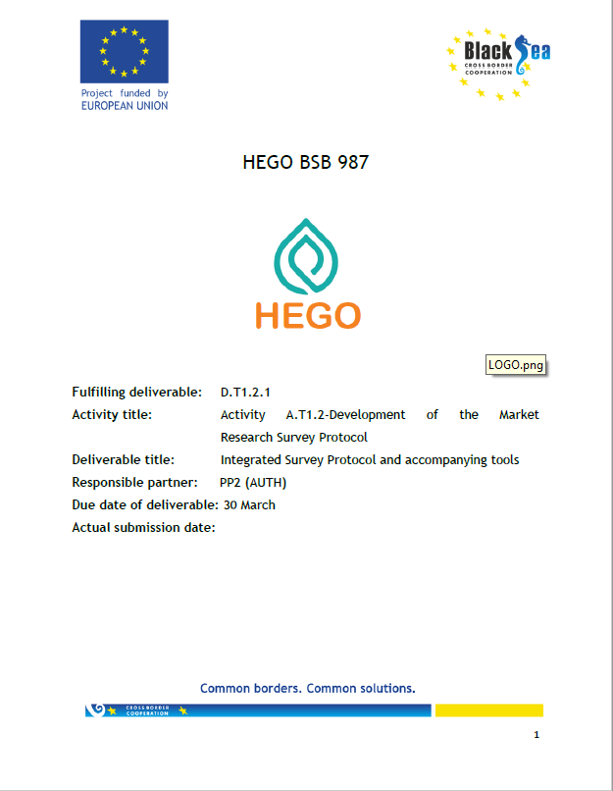
GA [T1]-Market Research for current situation and training needs on herb sector
Jul.20 – Apr.21
Activity A.T1.1-Market Research Review
Deliverable D.T1.1.1 - Market research studies review material
  Activity A.T1.2-Development of the Market Research Survey Protocol
  Deliverable D.T1.2.1 - Integrated Survey Protocol and accompanying tools
Activity A.T1.3-Implementation of Market Research Surveys
Deliverable D.T1.3.1 - Market Research Surveys folder
Activity A.T1.4-Processing and analysis of data collected from Market Research Surveys
  Deliverable D.T1.4.1 - Market Research Surveys’ Integrated Database
Activity A.T1.5-Final reporting on Market Research Surveys
Deliverable D.T1.5.1 - Final Cross-country Report on Market Research Surveys results

Slide 10


GA [T2]-Training programme for modernization of herb enterprises
  Jan.21 – Jun.22
Activity A.T2.1-Development of concepts and contents of training modules (curriculum)
Deliverable D.T2.1.1 - Training curriculum with description of modules structure and content
Activity A.T2.2-Development of training modules, training methodology and learning materials
Deliverable D.T2.2.1 - Training modules with materials & Training methodology
Activity A.T2.3-Organisation of training seminars in Project countries
Deliverable D.T2.3.1 - Final national reports and evaluation of training seminars
Activity A.T2.4-Adjustment of training modules in PP2 e-learning platform
Deliverable D.T2.4.1 - Adjustment Guide for introduction of learning modules and training methodology via PP2 e-learning platform
Activity A.T2.5-Organisation of training sessions via PP2 e-learning platform
Deliverable D.T2.5.1 - Users’ Guide for e-learning platform

Slide 11


GA [T3]-Establishment and operation of the network “Black Sea Herb Business Forum”
  Jul.20 – Dec.22
Activity A.T3.1 - Development of the Memorandum of Understanding and the Operational Plan of the Business Forum
Deliverable D.T3.1.1 - Memorandum of Understanding & Operational Plan
Activity A.T3.2-Design and upload of the HEGO e-Business Portal in PP3 Portal and development of Users’ Guide
Deliverable D.T3.2.1 - HEGO e-Business Portal Users' Guide
Activity A.T3.3-Development of the Implementation Guide for organizing the annual conferences of Black Sea Herb Business Forum
Deliverable D.T3.3.1 - Implementation Guide for organizing the Annual conferences of Black Sea Herb Business Forum
Activity A.T3.4-Organisation of Conferences of Business Forum in Greece, Armenia and Moldova
Deliverable D.T3.4.1 - Preparation & Reporting Folders for the Annual Conferences

Slide 12
GA [T4]-Preparatory actions for “Black Sea Herb Cluster”
  Jan.21 – Dec.22
Consultation
Review
Report
Maturity Toolkit
Activity A.T4.1-Review on case studies with clusters in Black Sea Project countries
Deliverable D.T4.1.1 - Review Report on case studies with clusters
Activity A.T4.2-Consultation process and discussion on the aims, objectives and structure of the Cluster with stakeholders and end beneficiaries
Deliverable D.T4.2.1 - Report on consultation process results
Activity A.T4.3-Development of the maturity toolkit for Black Sea Herb Cluster
Deliverable D.T4.3.1 - Maturity Toolkit for Black Sea Herb Cluster

Slide 13
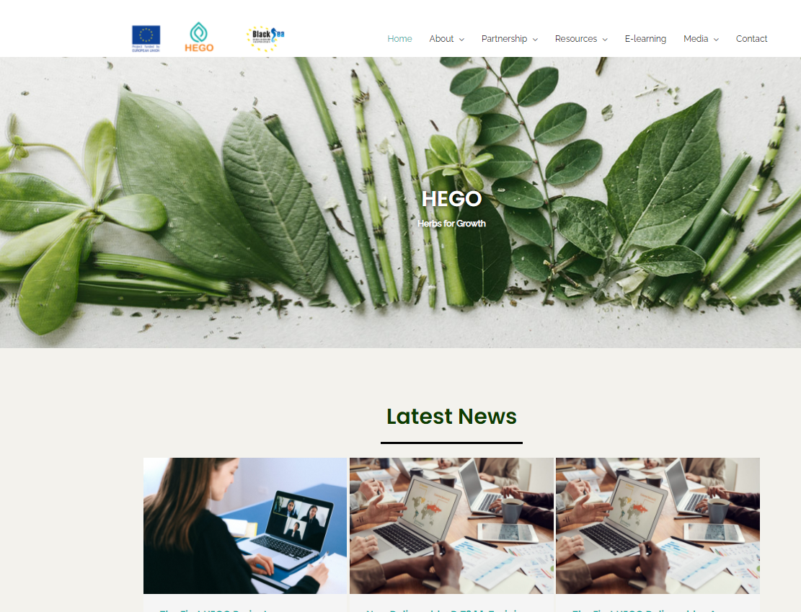
GA [C]-Communication
  Jul.20 – Dec.22
Activity A.C.1-Communication start-up activities
Deliverable D.C.1.1 - Communication Plan & Reports from activities implemented
Activity A.C.2-Digital activities
Deliverable D.C.2.1 - Development of Project website and presence in social media (www.hego-project.com)
Activity A.C.3-Promotional material
Deliverable D.C.3.1 - Promotional Material Packages
Activity A.C.4-Public Event(s)
Deliverable D.C.4.1 - Dissemination local meetings
Deliverable D.C.4.2 - National & International Conferences
Activity A.C.5-Publication(s)
Deliverable D.C.5.1 - Booklets with final Project results

Slide 14
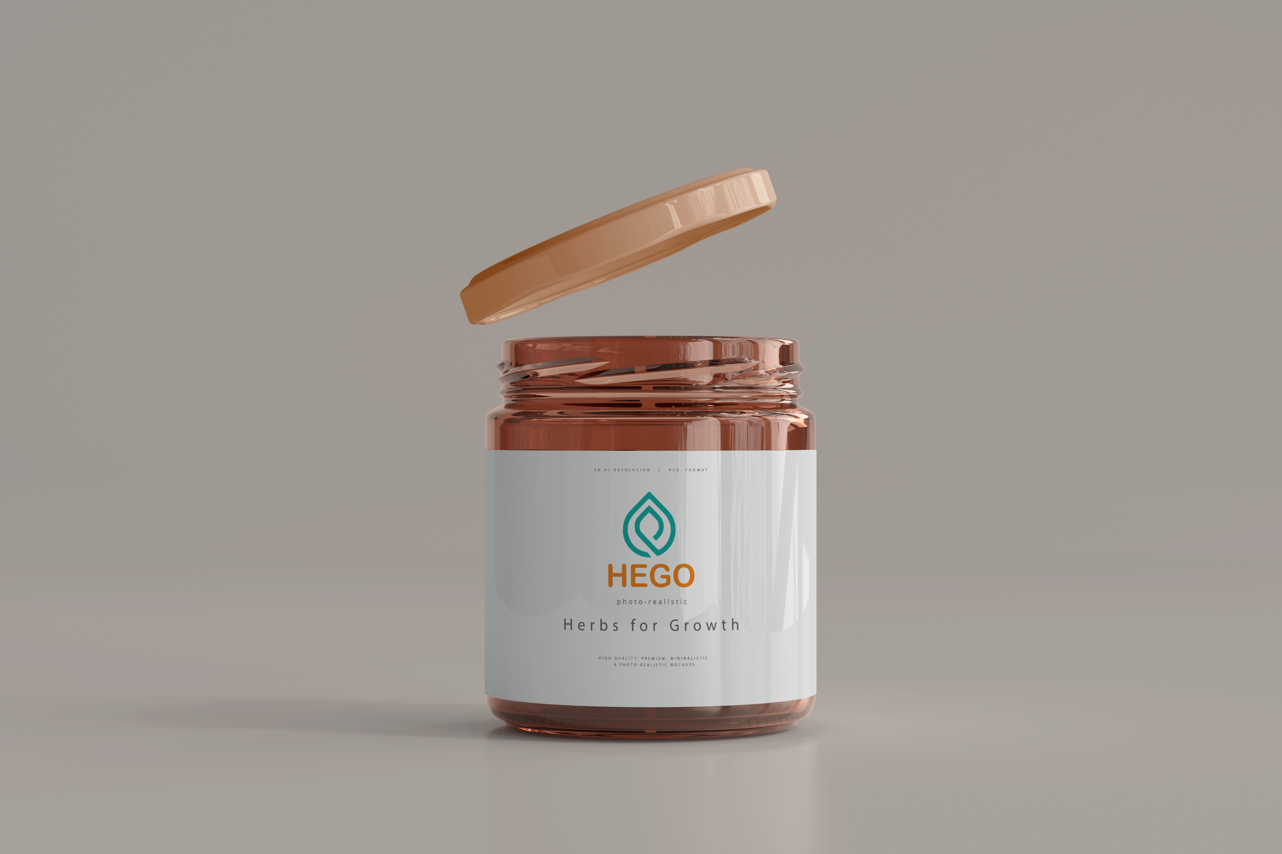
Expected Results
The HEGO project is an integrated intervention that involves the mobilization of all actors in the Value Chain of the Herb industry of the 4 participating countries, in order to achieve the following results:
To change the cultivation and processing methods of people involved towards sustainable modern practice (Diversification)
To improve farmers’ skills and knowledge on reducing wild collection, raise cultivation and create added-value herb products with modern and higher market demands and use funding programs for their farm or their clusters (Sustainability - viability)
To create a common strategy for cross-border trade to niche markets using ICT networking initiatives like the e-Business Portal and the e-Forum (Networking)
To perform all the appropriate preparatory work and activities for creating and maturing a Black Sea Herb Cluster plan which will include enterprises from different parts of the production chain from all 4 Project countries (Greece, Moldova, Georgia and Armenia) (Clustering)

Slide 15
Thank you for you attention!
Tassos LIVADIOTIS
Project Coordinator: ANETXA SA - Development Association of Halkidiki S.A., Greece

